Slide 1

— Remembrance Day —
TITANIC
FCSB_Team 4
Tham Mao Hen U2321551D
Ng Yi Xiang U2321562D
Law Zhi Xuan U2321546E

Slide 2
— Problem Statement —
To find out what is the best prediction model and the best predictor to predict the survival rate of the passengers on the Titanic

Slide 3

— Introduction —
WHY?
Titanic tragedy serves as a reminder of the inherent vulnerabilities within our society and transportation systems

Slide 4
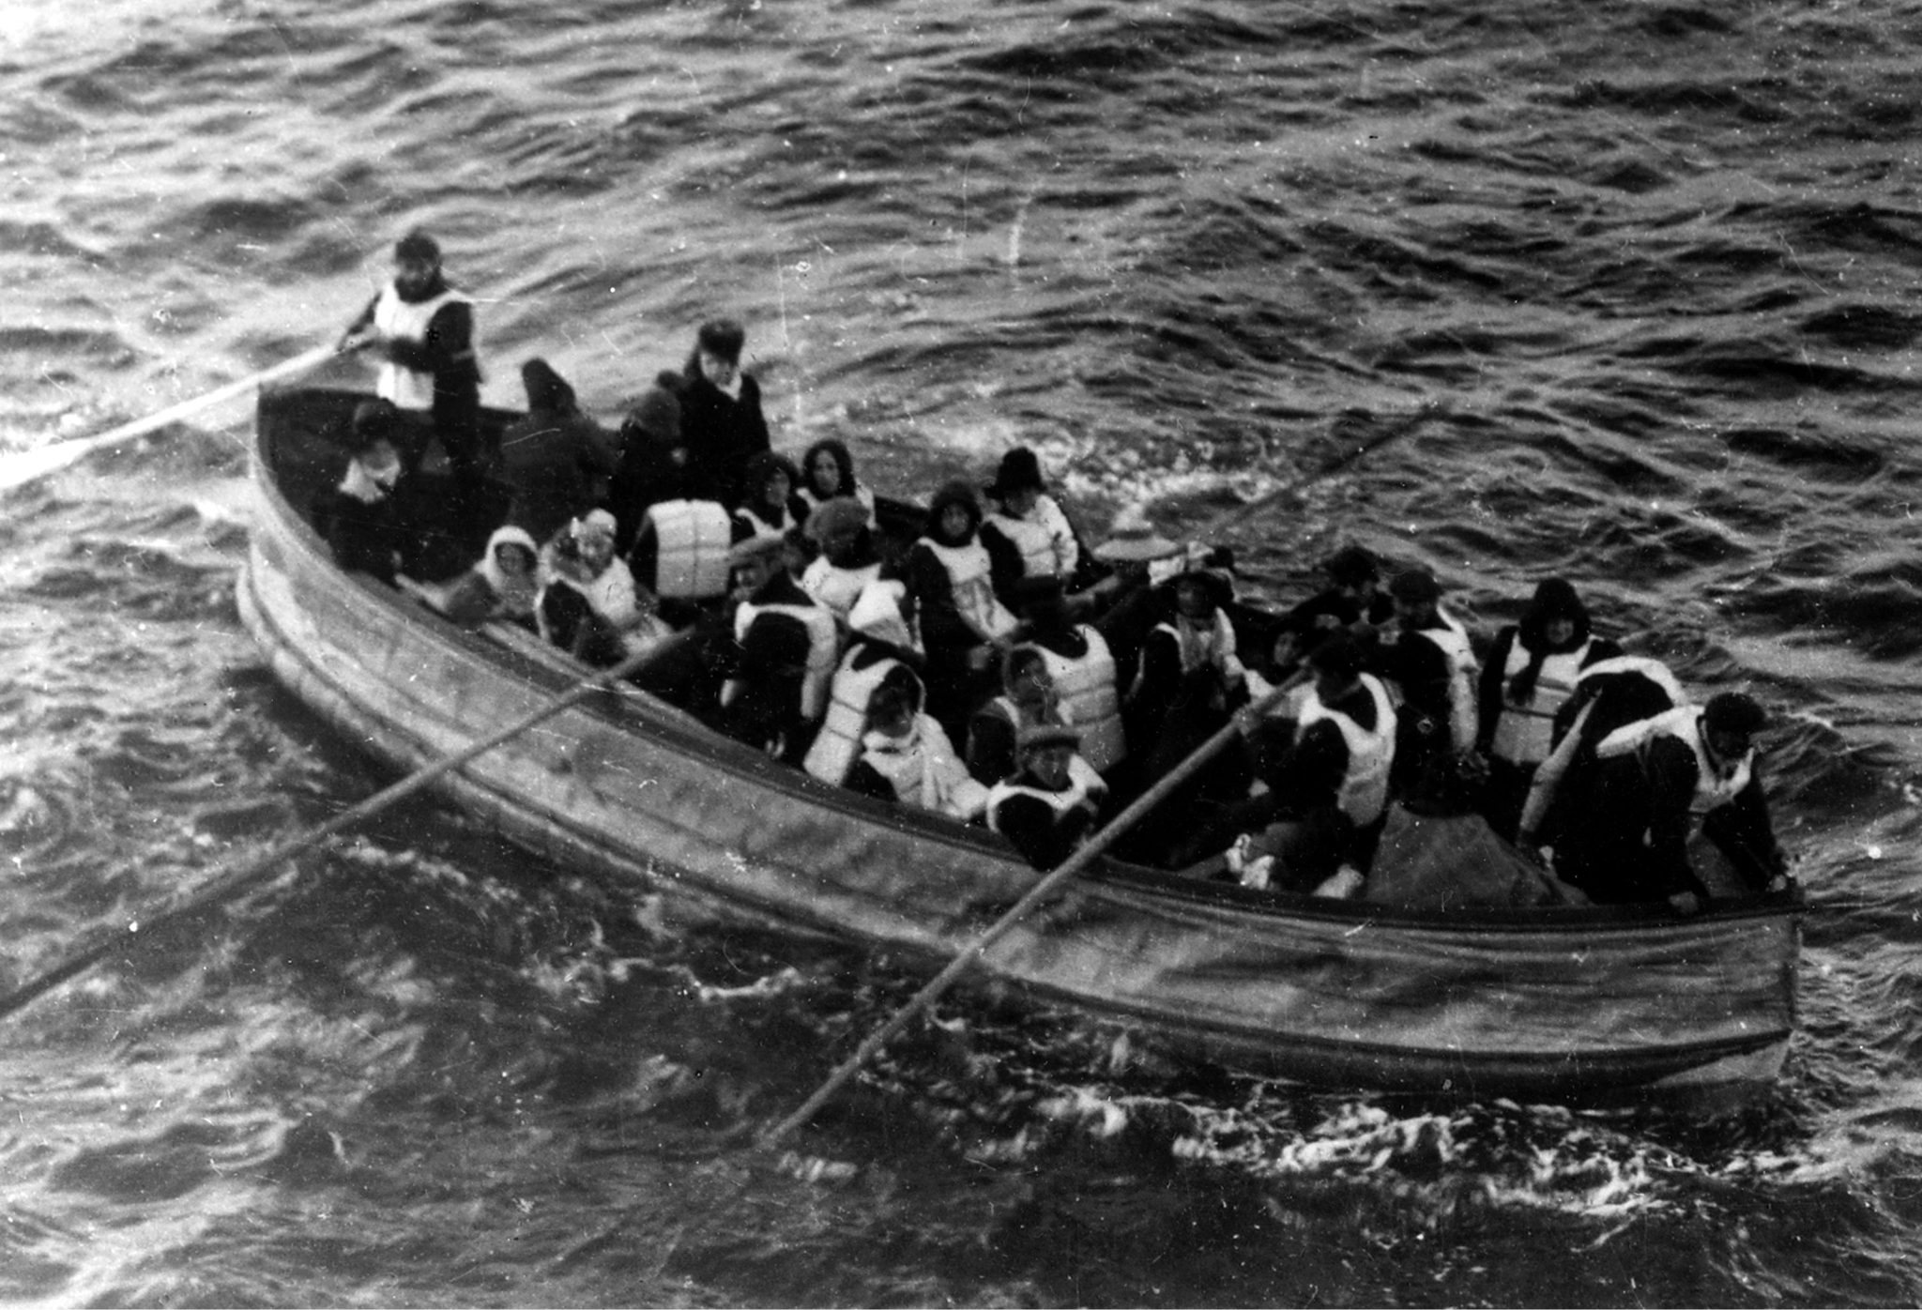

— What happened that night —

Slide 5



Our motivation lies in uncovering these patterns and leveraging them to develop a predictive model that could potentially save lives in future maritime disasters

Slide 6
— Data Processing —
1.
2.
3.
4.
Filling
Converting
Categorizing
Cleaning
Ensuring No Missing Values
Changing data to appropriate value types.
Grouping Data into Ranges
Cleaning/Removing unnecessary data

Slide 7
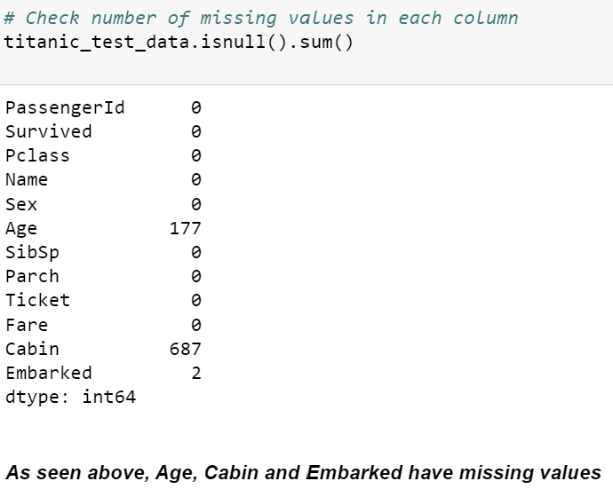
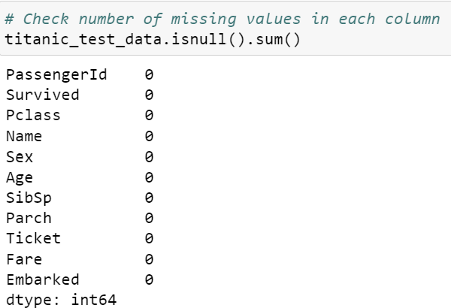
Before
— Data Processing —
1.
After
Filling
Filling Procedures
Age
Filled with Mean
Embarked
Filled with Mode
Ensuring No Missing Values

Slide 8
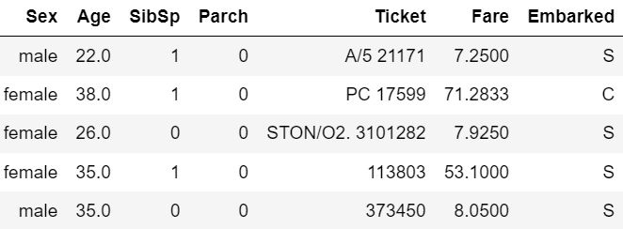
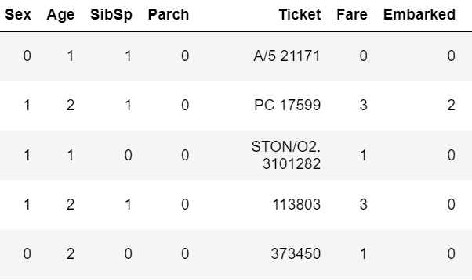
— Data Processing —
Before
2.
After
Converting
Conversion Procedure
Sex
Male -> 0
Female -> 1
Embarked
Southampton -> 0
Queenstown -> 1
Cherbourg ->2
Changing data to appropriate value types.

Slide 9
— Data Processing —
Before
3.
After
Categorizing
Categorizing Procedure
Age
Band 0 <= 16
17 <= Band 1 <= 32
33 <= Band 2 <= 48
49 <= Band 3 <= 64
Band 4 >= 65
Fare
Band 0 <= 8
8 < Band 1 <= 15
15 < Band 2 <= 31
Band 3 >= 32
Grouping Data into Ranges

Slide 10
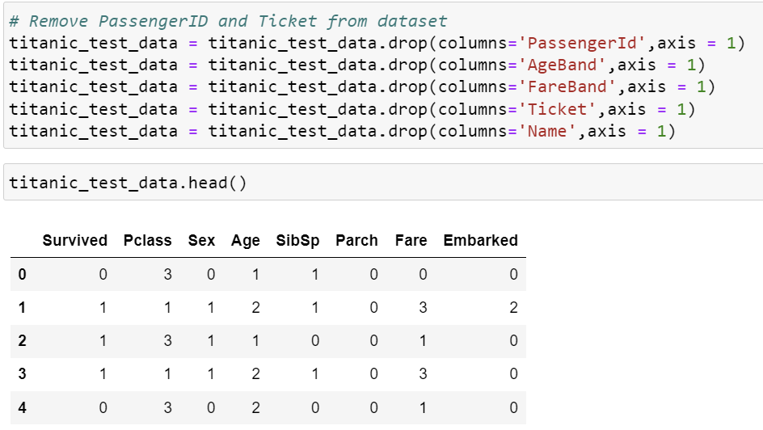
— Data Processing —
4.
Cleaning
Removing Unnecessary Variables
Removed Variables
PassengerId
Name
Ticket
FareBand
AgeBand
Cleaning/Removing unnecessary data

Slide 11
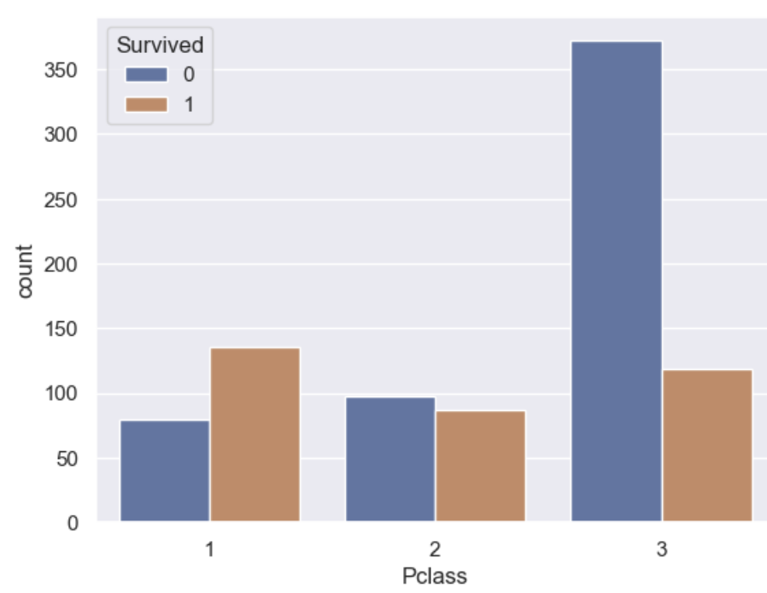
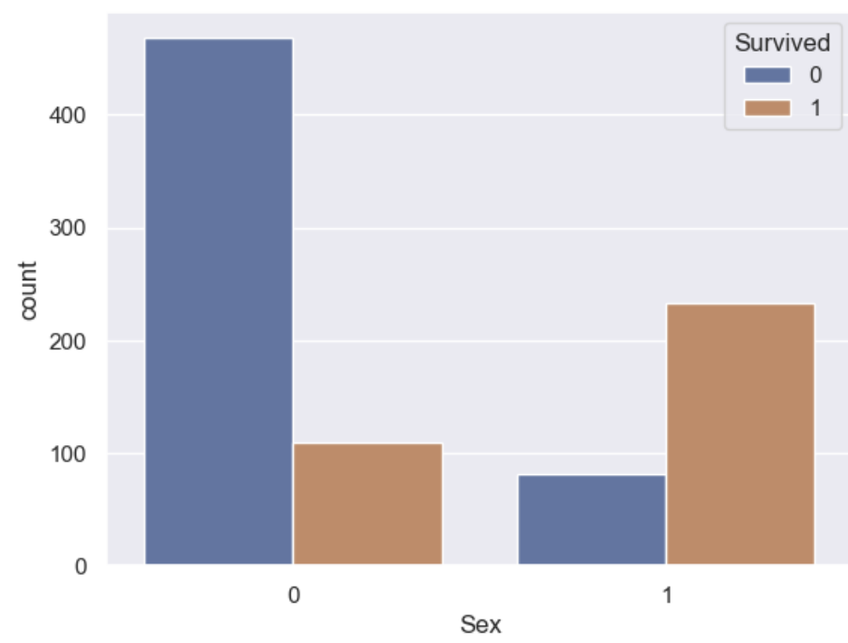
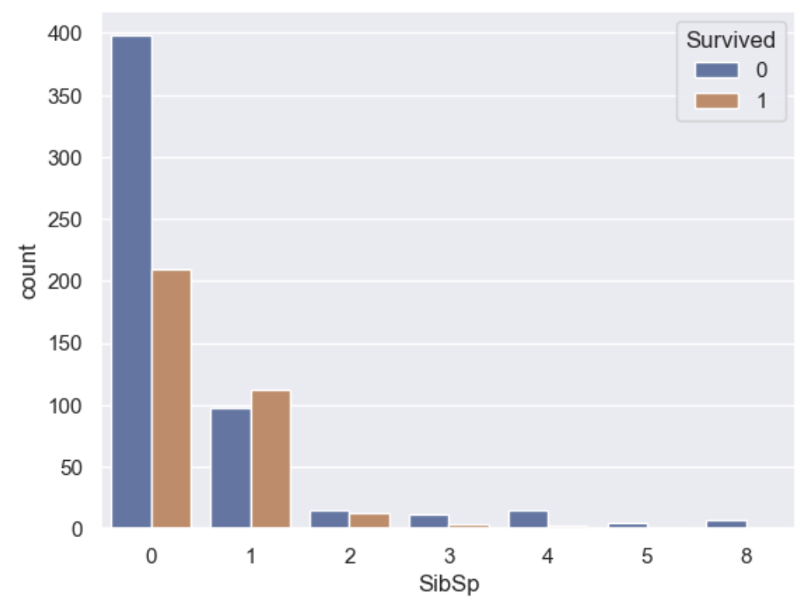
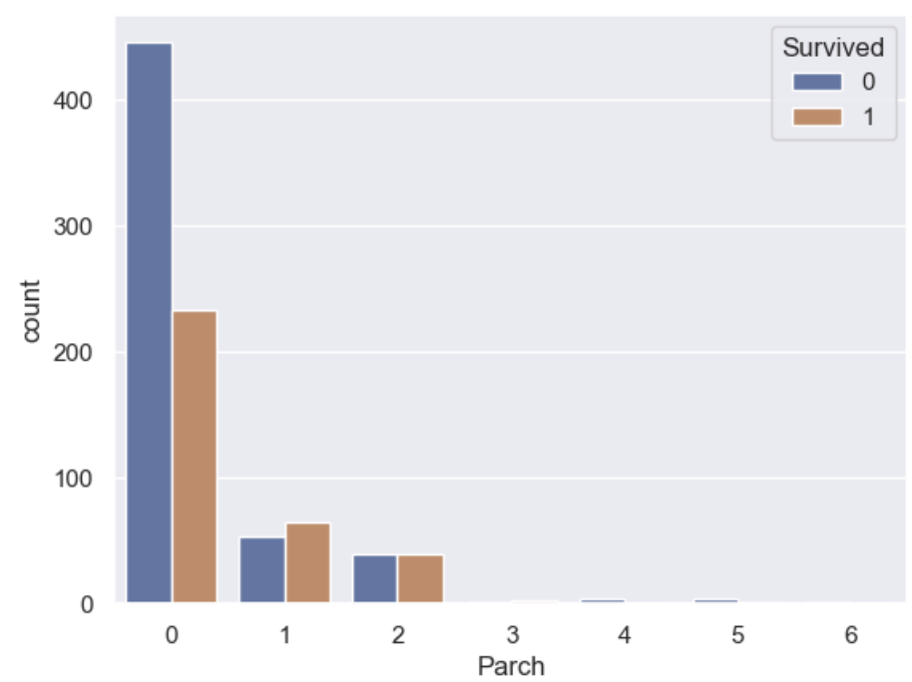
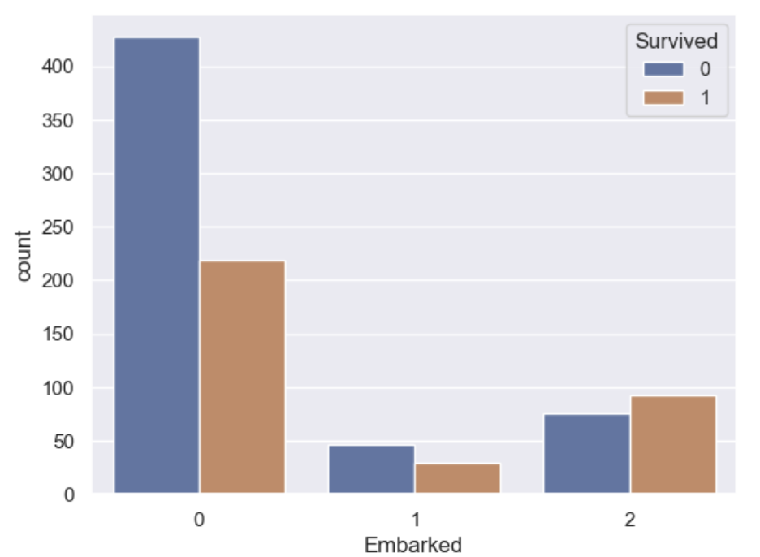
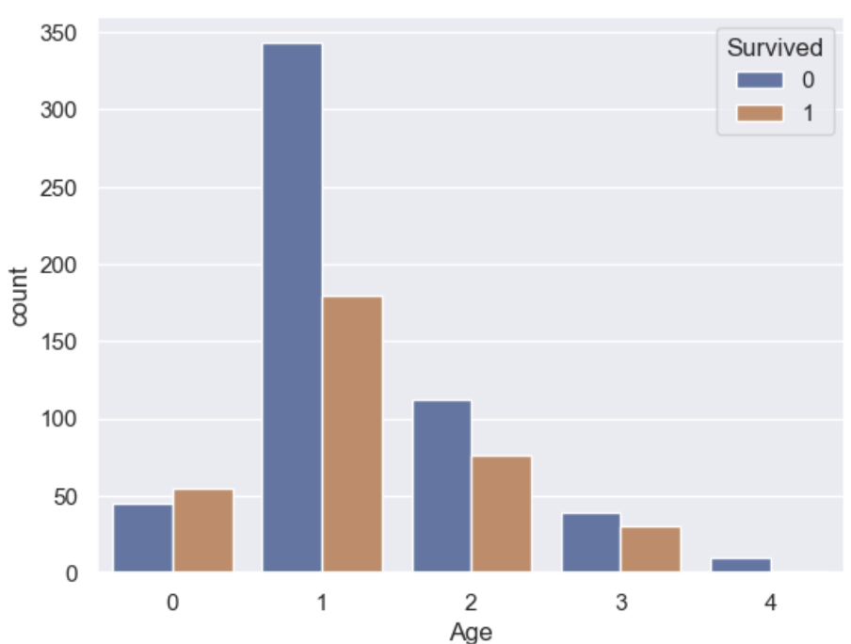
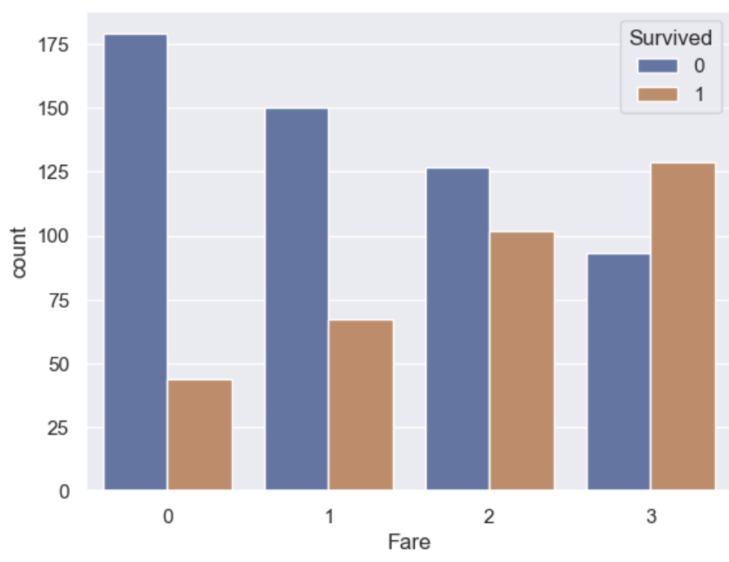
— Bar Plots—
Pclass
Sex
SibSp
Parch
Embarked
Age
Fare

Slide 12
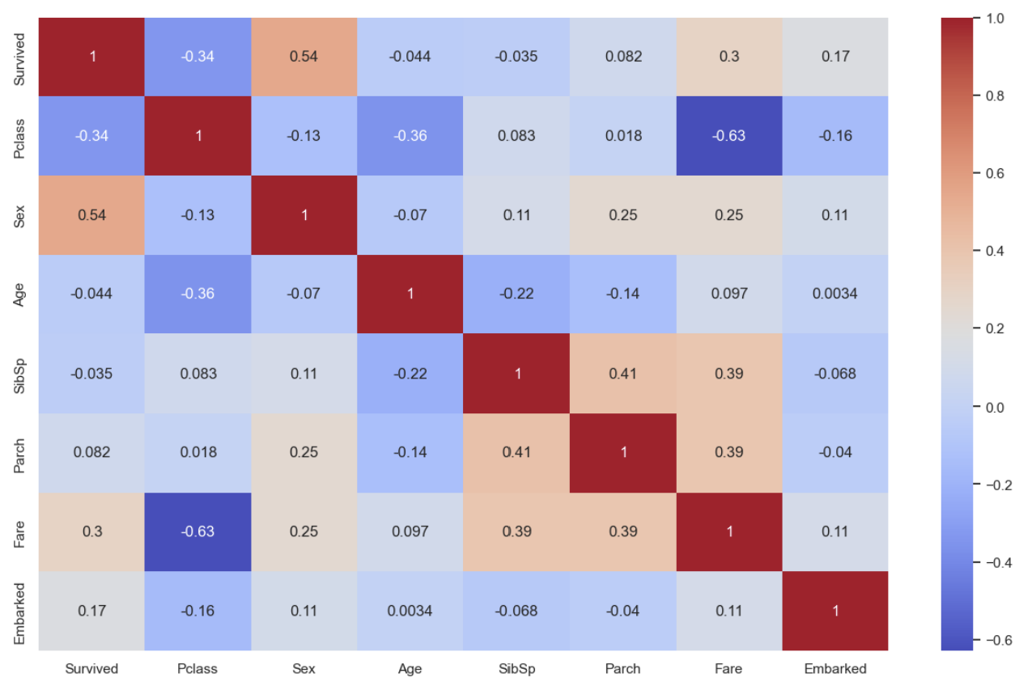
— Heatmap and Conclusions—
Conclusions
Highest Impact Variables
Sex
Fare
Pclass
Outlier
Age
Due to higher survival rate for only youngest age range

Slide 13
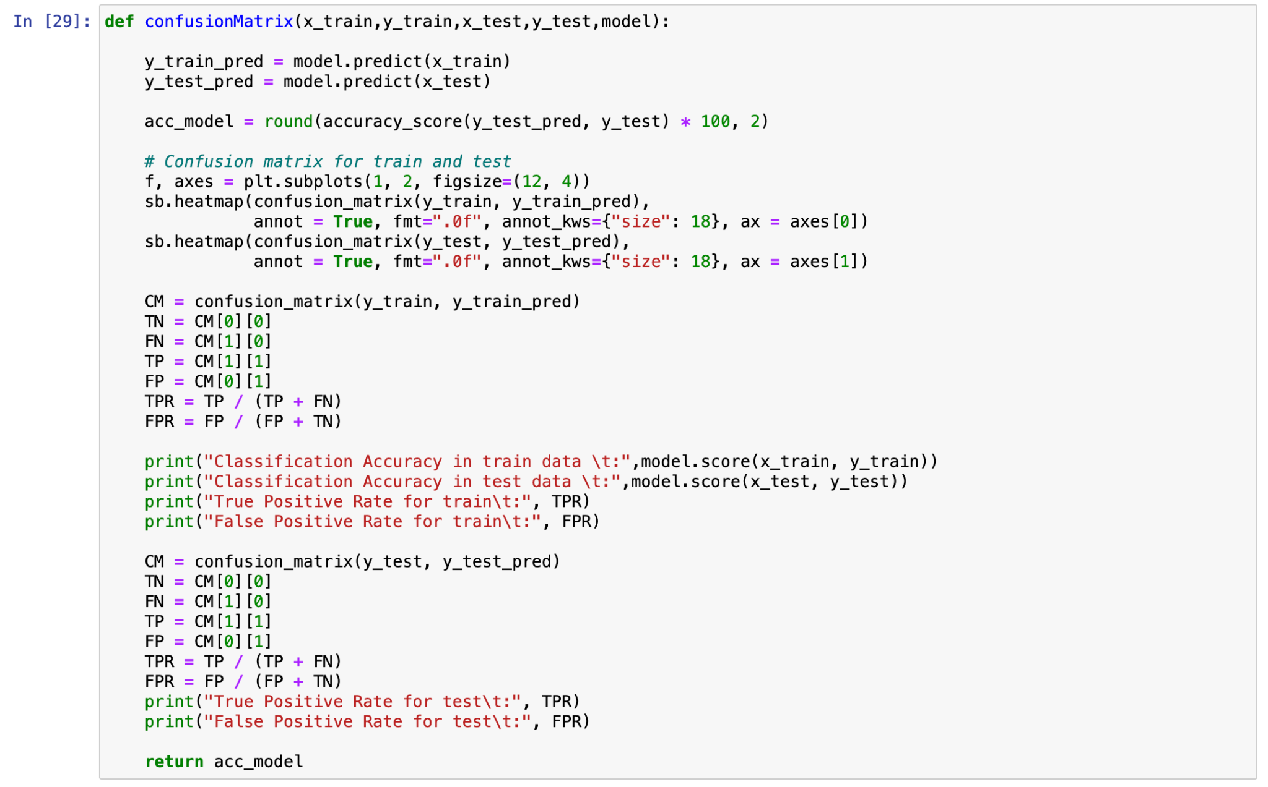
— Splitting into train and test—

Slide 14
— Choosing the best model—
Logistic Regression
Random Forest
k-Nearest Neighbors
Perceptron
Support vector machines
Decision tree
Naive Bayes Classifier

Slide 15
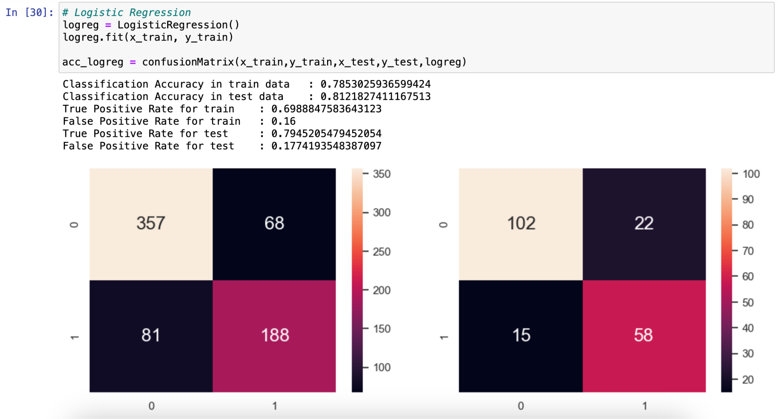
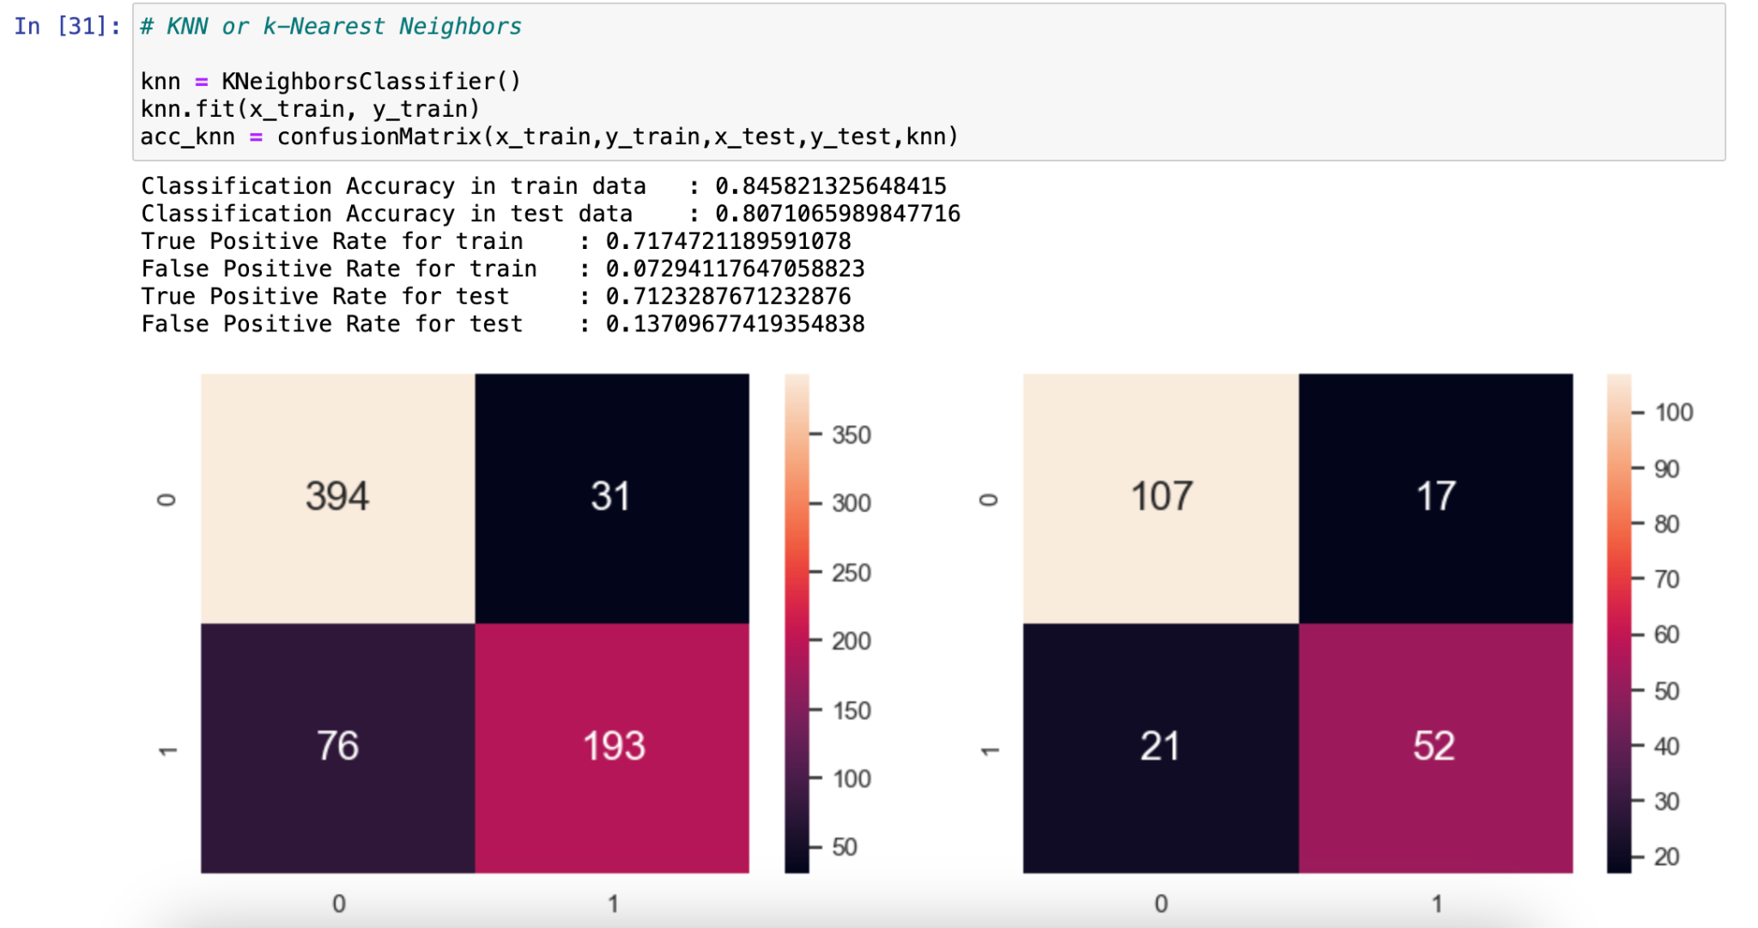
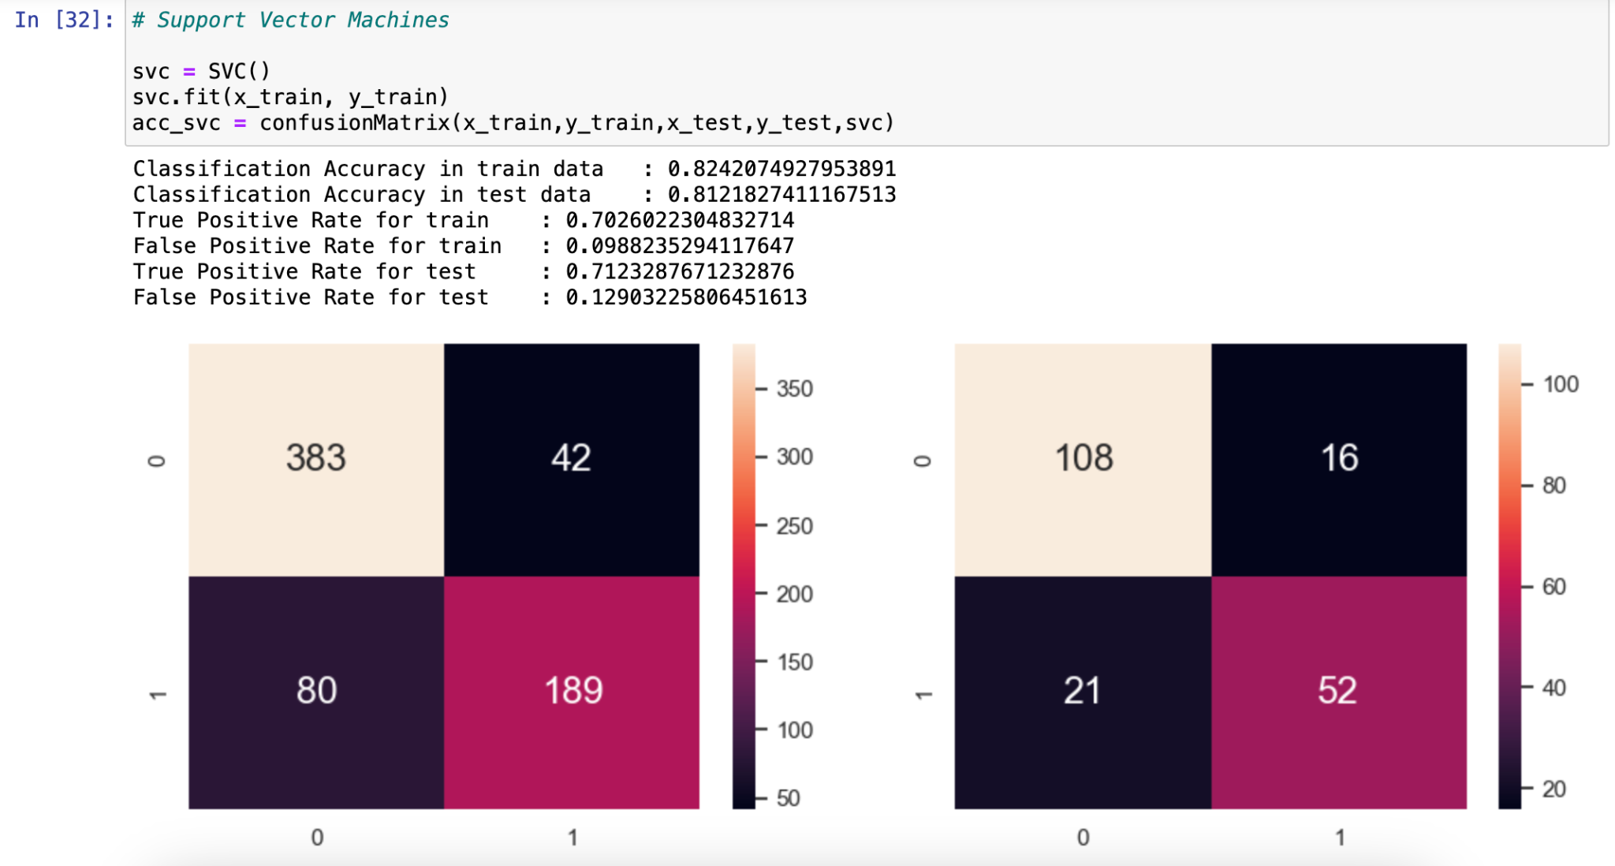
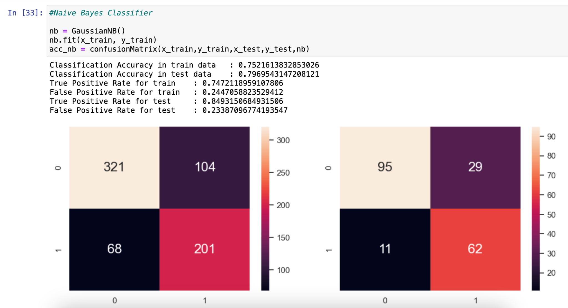
— Confusion Matrix Comparison —
Logistic Regression
k-Nearest Neighbors
Support Vector Machines
Naive Bayes Classifier

Slide 16
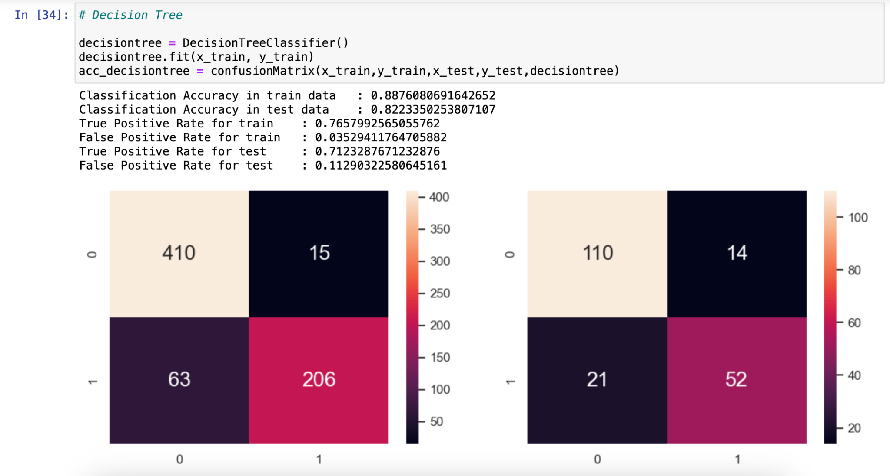
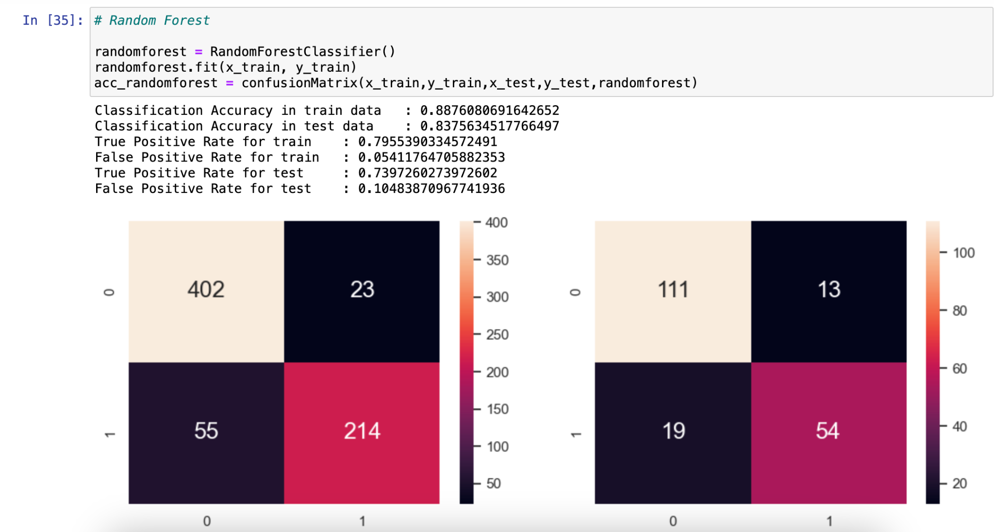
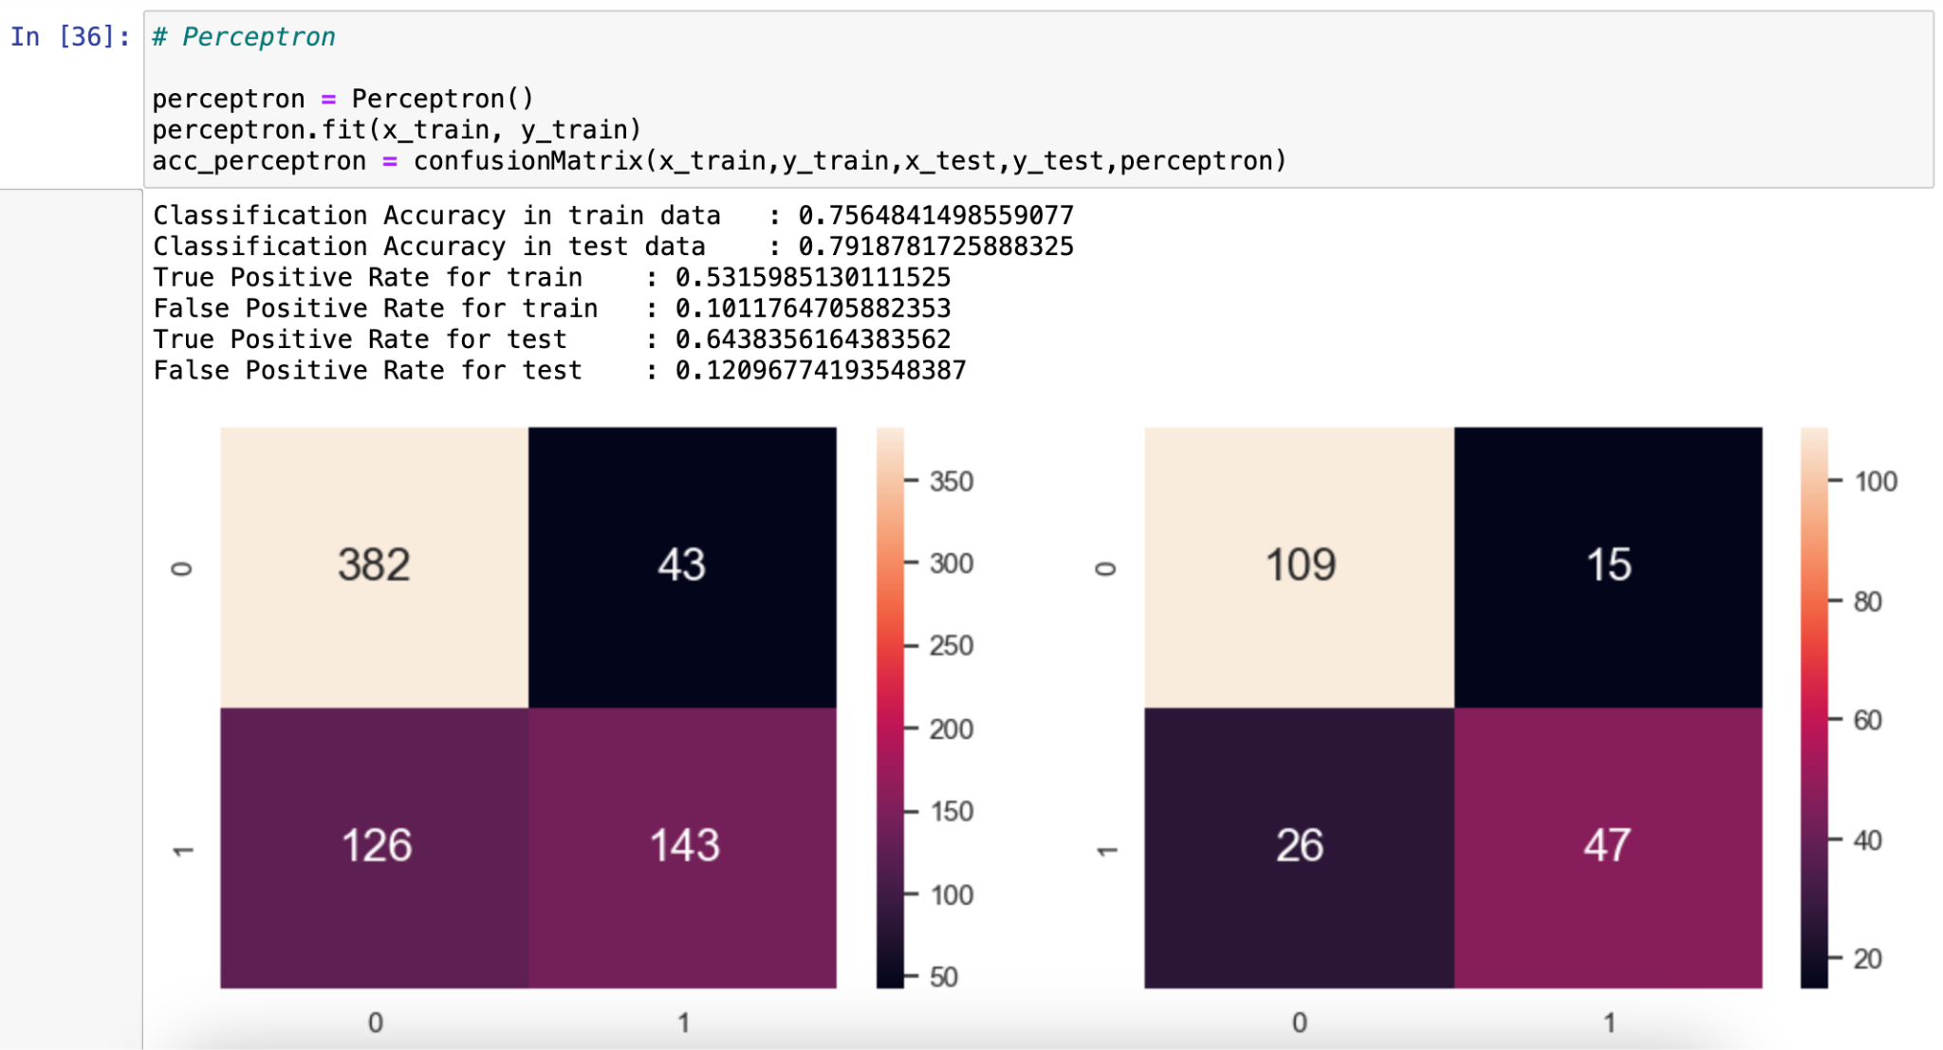
— Confusion Matrix Comparison —
Decision Tree
Random Forest
Perceptron

Slide 17
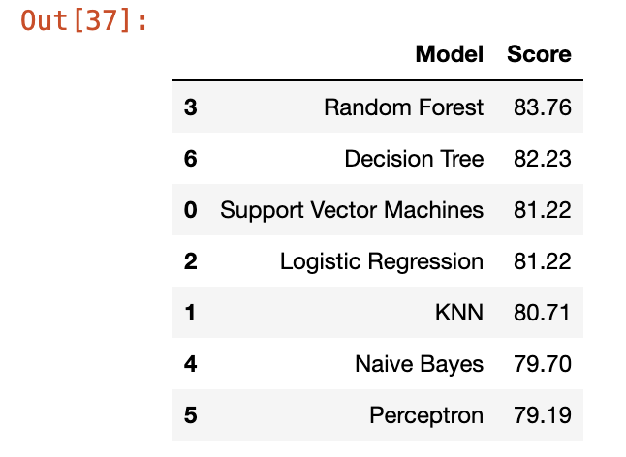
— Best Model —

Slide 18
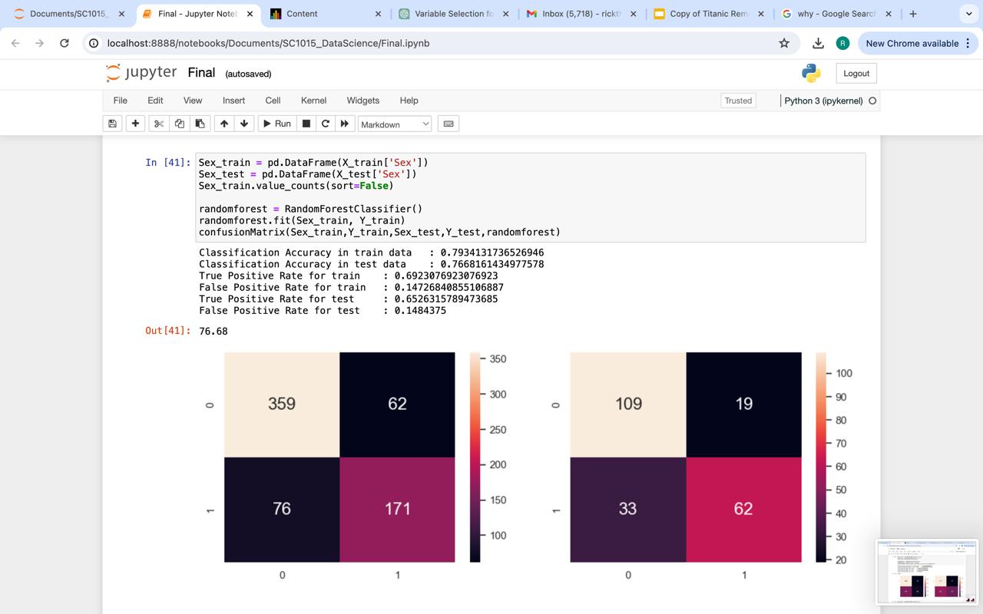
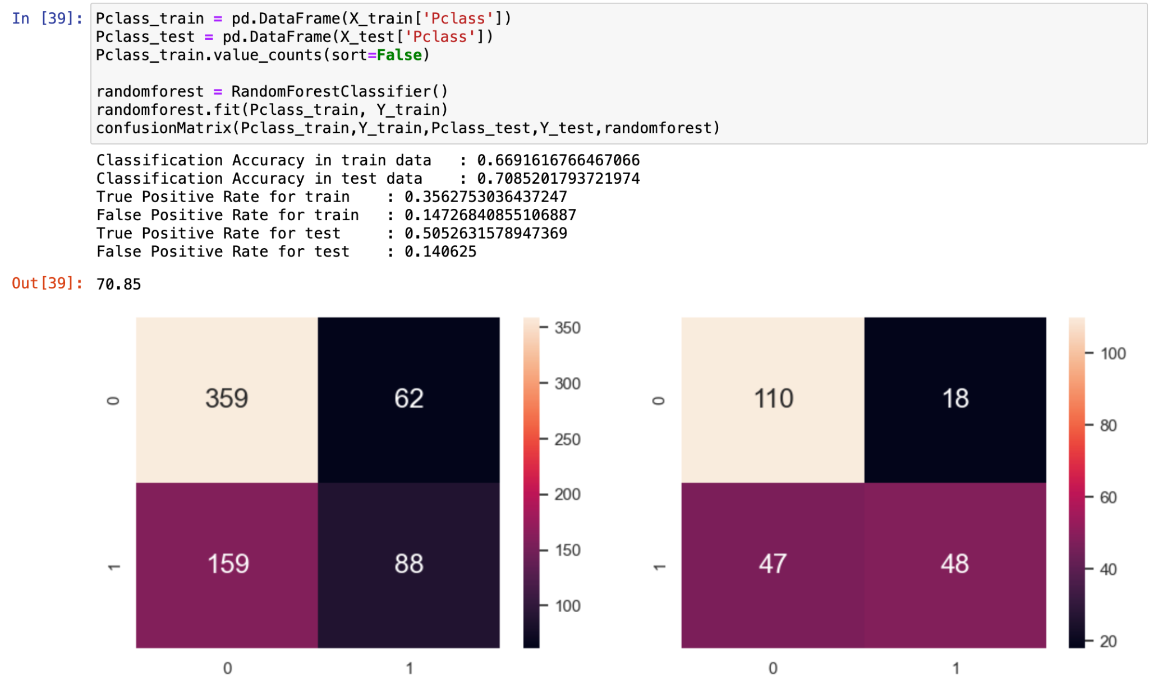
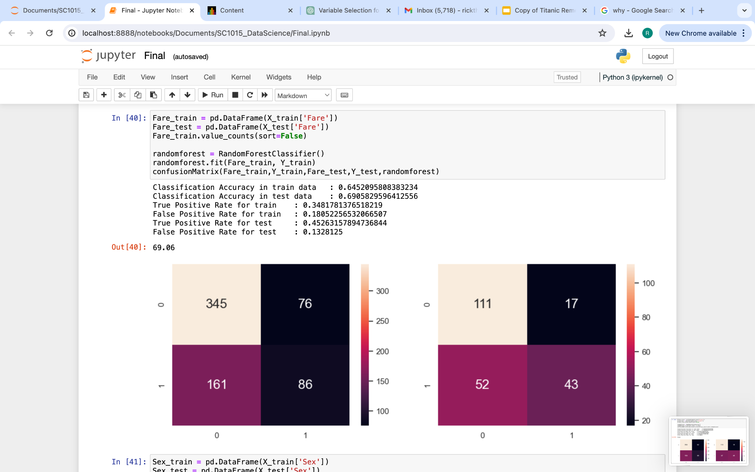
— Finding the best predictor —
Sex vs Survived
Pclass vs Survived
Fare vs Survived

Slide 19
— Best Predictor and Model —
Sex vs Survived
Random Forest

Slide 20


— Something Interesting—
Data cleaning

Slide 21
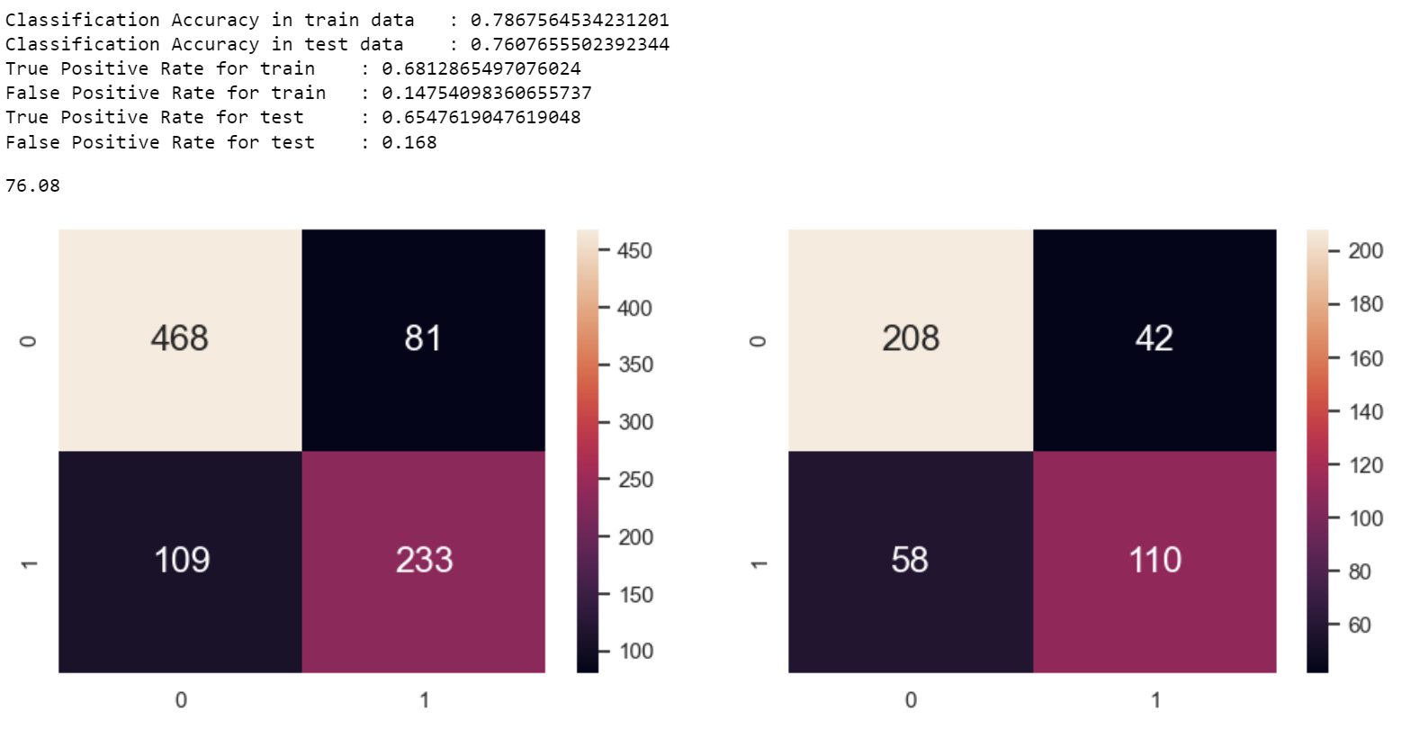
— Implementing to actual data —

Slide 22
“Ladies, Elderly and Children First”

Slide 23
Thanks!

